Slide 1

Project - 1
Create a Static Website and Deploy in AWS using S3 Service
In the presentation , we give a step by step how we host a static website and benefits of static websites also uses

Slide 2

First we Create a s3 bucket and s3 bucket what… it’s nothing its basically public cloud storage resource available in Amazon Web Services (AWS) Simple Storage Service (S3) platform.
While creating bucket we only uncheck block all public because we make a public bucket if we check the block all public access the bucket could be create a private.

Slide 3
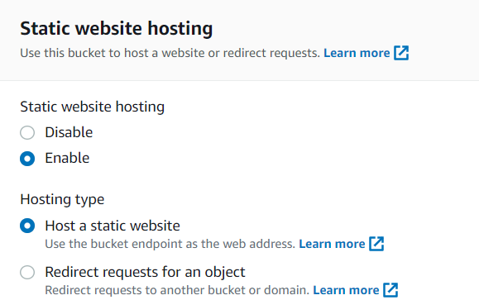
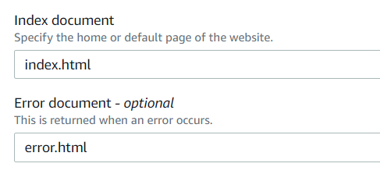
After we create a bucket we go to properties option in the bucket and enable the Static website hosting static website is what it’s basically deliver a HTML,CSS, Javascript files through the use of s3 bucket Static websites are very low cost, provide high-levels of security and better experience to user.
for host the website which we want deploy with the given index document and error document

Slide 4
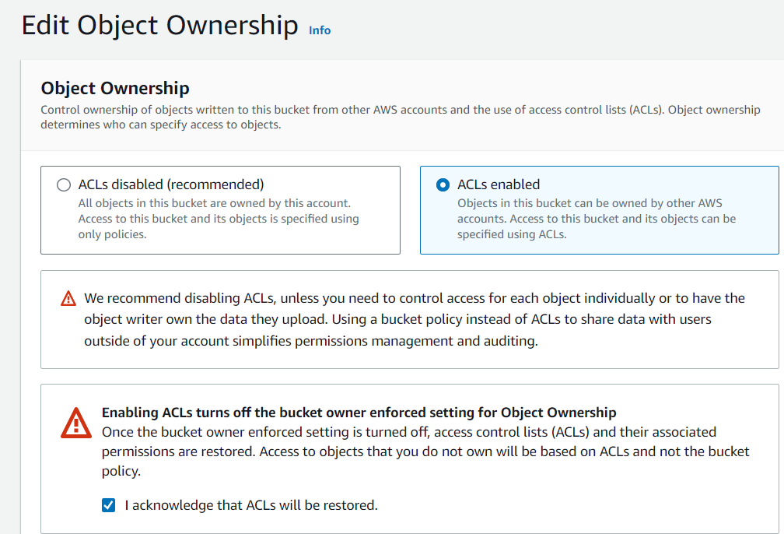
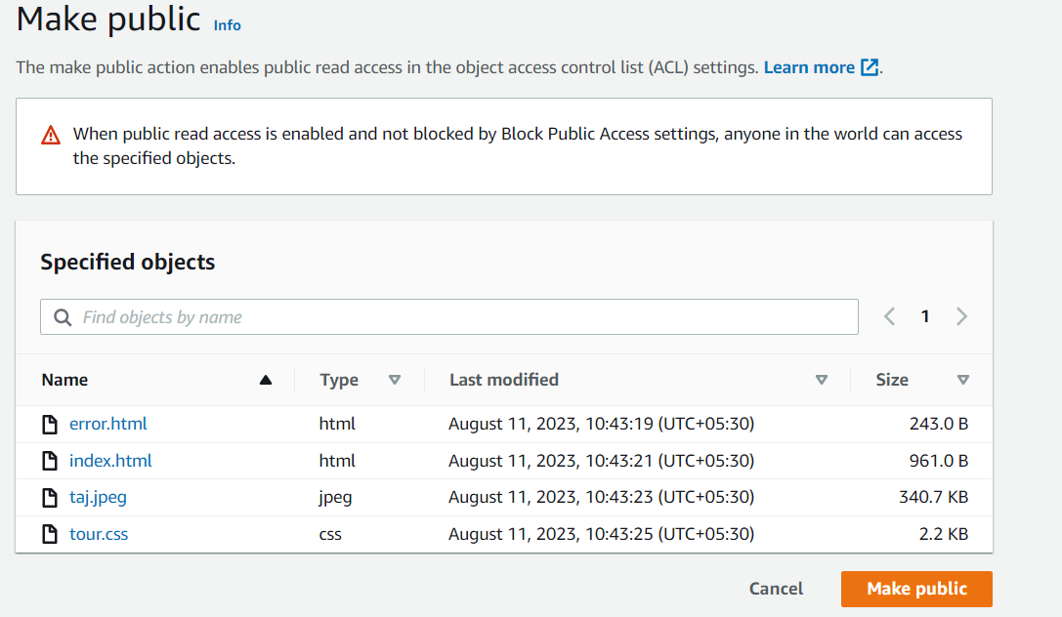
After we enable static hosting website
Now ACL is disabled make sure you will enable the ACL from permissions.
Why we enable the ACL in bucket because after we upload a object manually make a public using public ACL.

Slide 5
After we enable the ACL now
Upload a two file in a bucket
First one is index.html and second one is error.html.
We create a website using html language and save it to the name of index.html and now we also write a code with using html and given the name error.html.

Slide 6
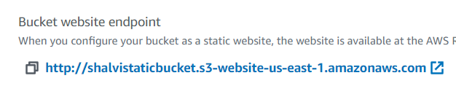
Now after we done every steps we test our websites through the given link

Slide 7
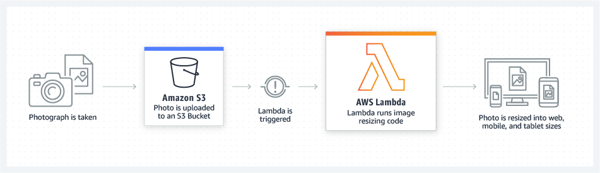
Project - 1
Create Serverless Resized Image using lambda in AWS.

Slide 8
Create an S3 Bucket
Go to the AWS Management Console.
Navigate to the S3 service.
Click the "Create bucket" button.
Follow the prompts to configure your bucket. Make sure to note down the bucket name.

Slide 9
Create an AWS Lambda Function
Go to the AWS Management Console.
Navigate to the Lambda service.
Click the "Create function" button.
Choose "Author from scratch".
Fill in the details for your function:
Function name: Choose a name for your Lambda function.
Runtime: Choose "Python" (or another supported language).
Role: Create a new role with permissions to read from S3 and write to CloudWatch Logs.
Click "Create function".

Slide 10
Add Trigger for S3 Bucket
In the Lambda function you just created, go to the "Designer" section.
Click "Add trigger".
Choose the "S3" trigger type.
Select the S3 bucket you created earlier.
Choose the event type (e.g., "Object Created (All)").
Set the prefix and suffix if needed.
Click "Add".

Slide 11
Write Lambda Code for Resizing Images.
1- Zip the python script and the “Pillow” library (located in the ‘PIL’ to Folder ) into a zip file.
2- Upload the zip file to the Lambda function as a deployment package.
3- Save the Lambda Function.

